Slide 1
Paramedic
Ventilator Management

Slide 2
Ventilator Training Goals
Determine the type of injury.
Familiarize with MLREMS Protocol.
Familiarize with LTV 1000/1200
Familiarize with AutoVent 3000
DOPE and trouble shooting

Slide 3
What type of respiratory problem?
Crashing Patient
  Medical 500
  Respiratory Arrest
Lung Injury
  ARDS (adult respiratory disease syndrome)
Obstructive
  Asthma
  COPD

Slide 4
What type of respiratory problem?
Crashing Patient
Use
  Once you have ROSC
  Enroute to hospital with crashing patient

Slide 5
What type of respiratory problem?
Lung Injury patients
Injured lungs are baby lungs
  Delicate
  Less lung for tidal volume and gas exchange
ARDS is injury to lung tissue often from sepsis
5 of PEEP to start is good.
  PEEP DOES NOT POP LUNGS

Slide 6
What type of respiratory problem?
Obstructive Patients
Obstructive Patients are your Asthma and COPD patients.
Air is trapped in their alveoli
Slower rates
Lower PEEP is ok remember obstructive patients auto PEEP

Slide 7
MLREMS Ventilator Protocol 2.32
In Accordance with Policy 9.19
A patient who requires manual ventilation in the pre-hospital environment who has received emergent endotracheal
intubation or who has a pre-existing tracheostomy tube and meets the following criteria:
  At least 10 minutes of patient contact expected
Weight ≥ 40 kg
Systolic blood pressure ≥ 90
Able to ventilate without difficulty

Slide 8
MLREMS Ventilator Protocol 2.32
In Accordance with Policy 9.19 (Cont.)
Paramedics Must Provide on a ventilator patient
  Standard Medical Care
  SpO2
  ECG
  ETCO2 with Continuous Waveform

Slide 9
MLREMS Ventilator Protocol 2.32
In Accordance with Policy 9.19 (Cont.)
Field Calls
  Start with BVM ventilations while you confirm ventilator and hemodynamic stability
  BVM with oxygen @ 100% for at least 2 minutes prior to ventilator.
  Set Ventilator (if available)on Assist Control
    Rate (f) 10-12
    FiO2 1.0 (100%)
    Tidal Volume (Vt) 5-6ml/kg Preferred body weight.
    PBW = (2.3 x Height (in) – 60) + 45 for women and 50 for men.
      Example: 72 inch tall male
          [2.3 x (72-60)] + 50 = 77.6 kg for a preferred body weight.
          77.6 kg x 6 ml = 465.6 or 465 cc Vt.

Slide 10
MLREMS Ventilator Protocol 2.32
In Accordance with Policy 9.19 (Cont.)
Lets try one more Tidal Volume Calculation!
  48 year old female
  66 inches tall
  PBW = (2.3 x Height (in) – 60) + 45 for women and 50 for men.
  Tidal Volume (Vt) 5-6ml/kg Preferred body weight.
  Set Ventilator (if available)on Assist Control.
  (2.3 x 66 – 60) + 45 = 58.8 lets say 59 for ease so the pt’s PBW is 59kg.
  59kg x 6ml = 354ml
  So the Vt is 355 for this patient

Slide 11
MLREMS Ventilator Protocol 2.32
In Accordance with Policy 9.19 (Cont.)
Field Calls (Cont.)
Adjust Vent settings to achieve
  SpO2 of > 96%
  EtCO2 38-42
  Peep at 5 cm H2O May adjust up to 10

Slide 12
Failing Ventilation
If patient becomes hypoxic, hypercarbic, or has increased work of breathing, discontinue the ventilator and perform BVM ventilations per Airway Management Protocol (2.0 or 2.1).

Slide 13
Evaluating Ventilator Problems with DOPE
Dislodged (low pressure)
  Moved from airway
  Circuit fell off
Obstructed (High pressure)
  Kink in circuit
  Suction Required

Slide 14
Evaluating Ventilator Problems with DOPE
Pneumothorax (High Pressure)
  Unequal lung sounds
  Vitals change
Equipment failure
  Loss of power
  Circuit failure
  Loss of oxygen

Slide 15
Call for help!
Remember that first and foremost the welfare of the patient is priority number one.
  Formulate a plan
  Call medical control

Slide 16
Stable Outpatient
MLREMS Defined as:
“A patient on a ventilator in an outpatient setting with no acute cardiac or respiratory complaints who is requesting ambulance transport”
These are primarily trach patients. Outpatient are usually not intubated.

Slide 17
Stable Outpatient
Provide
  ECG
  SpO2
  EtCO2 with Waveform
  If a RTT is accompanying the patient, that provier will manage the vent.
  With no RTT the Paramedic will utilize the patients exiting settings on their current or transport ventilator.
  Paramedic may increase FiO2 if required by the patient

Slide 18
Stable Outpatient
If the patient becomes Hypoxic, Hypercarbic or has increased work of breathing and there is no RT:
  Discontinue Ventilator
  Perform BVM ventilations per airway management protocol (2.0 or 2.1)
  Every time you move a patient check the ETT and listen to lung sounds.
  Again Visit DOPE:
    Dislodged
    Obstruction
    Pneumothorax
    Equipment failure

Slide 19
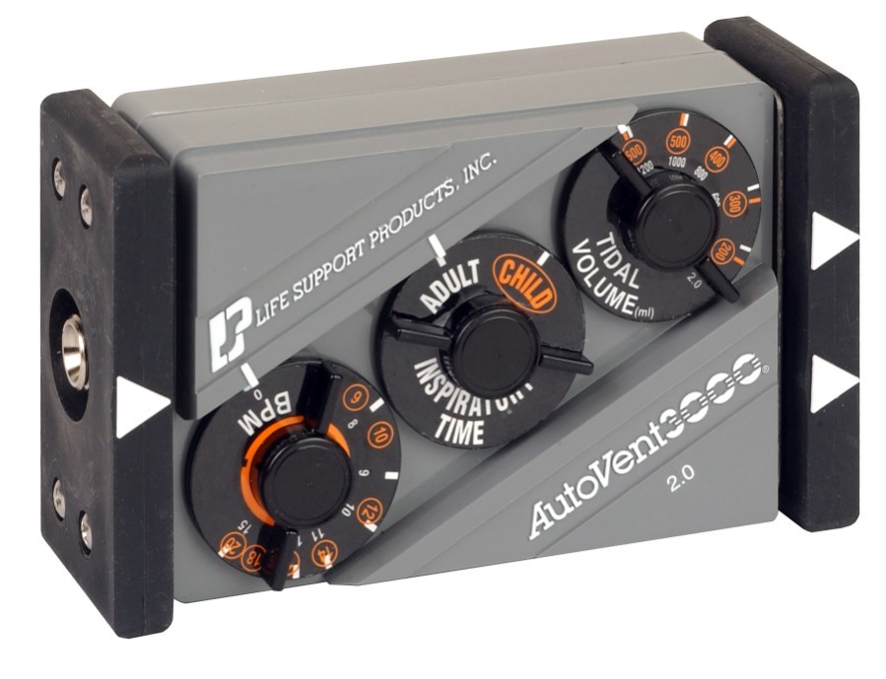
AutoVent 3000

Slide 20
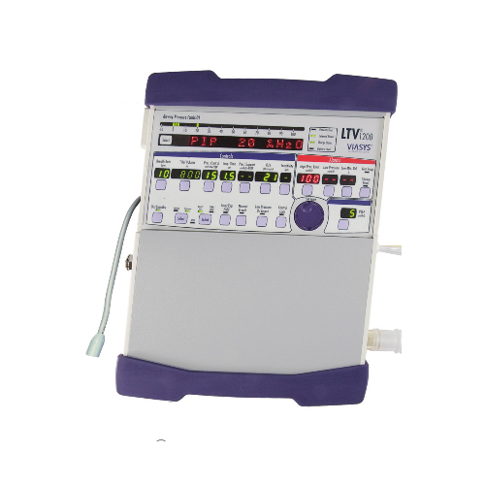
LTV 1200

Slide 21
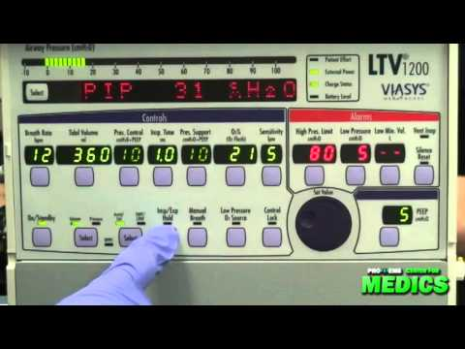
LTV Controls

Slide 22
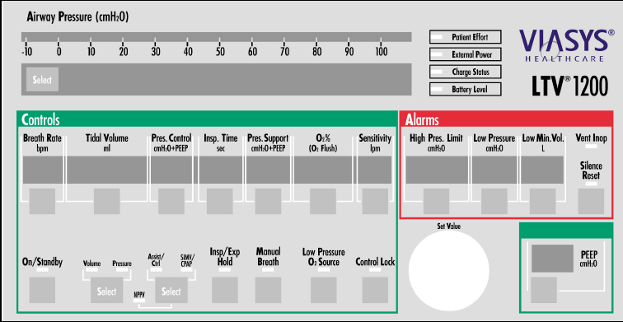
Settings for LTV 1200
Rate (f)
Tidal Volume (Vt)
FiO2
Mode
PEEP
Power

Slide 23
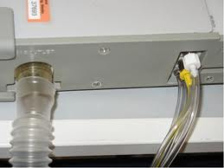
Transducing and Monitoring
Vent Circuit Attachment
Transducing lines are attached with:
  White
  Yellow
  Slide on Tube

Slide 24
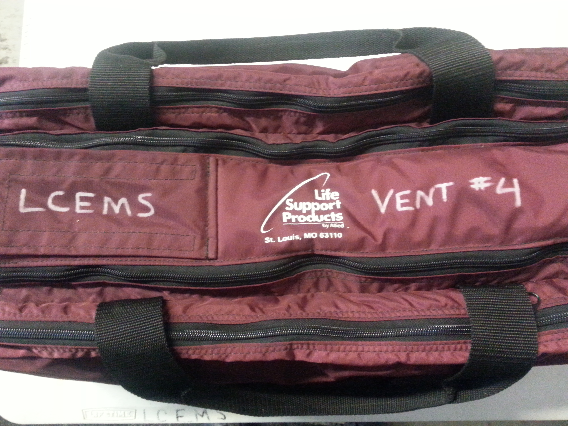
The Auto Vent 3000

Slide 25
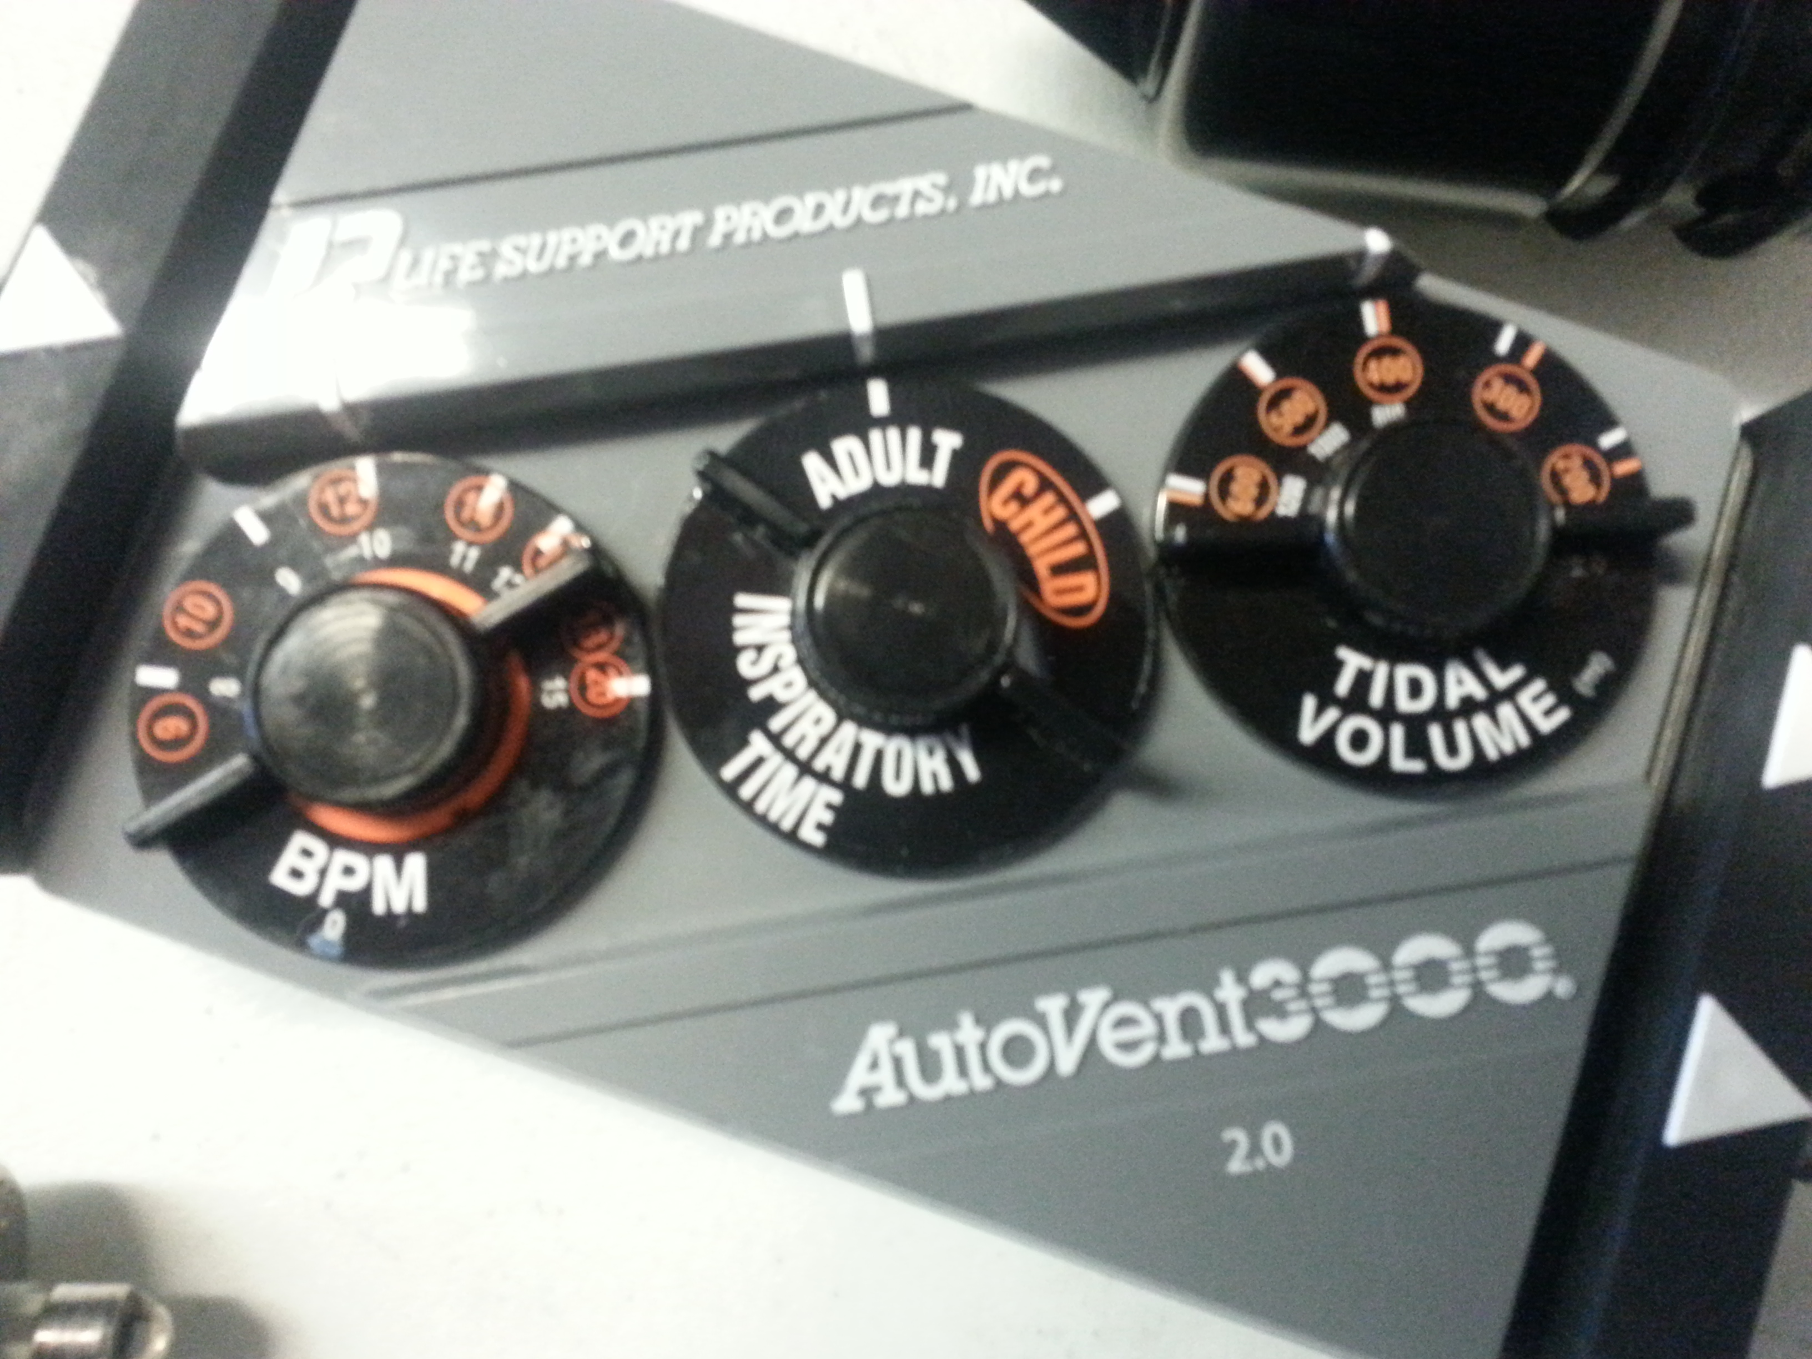
AutoVent 3000
BPM is your Rate (f)
Setting for respiratory time
  Adult
  Child
Tidal Volume (Vt)

Slide 26
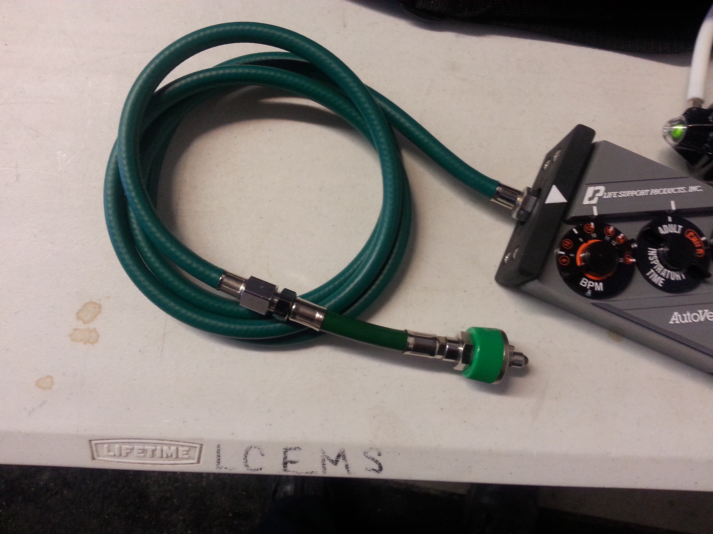
AutoVent 3000
Quick connection to oxygen supply.
Removable for high pressure fitting.

Slide 27
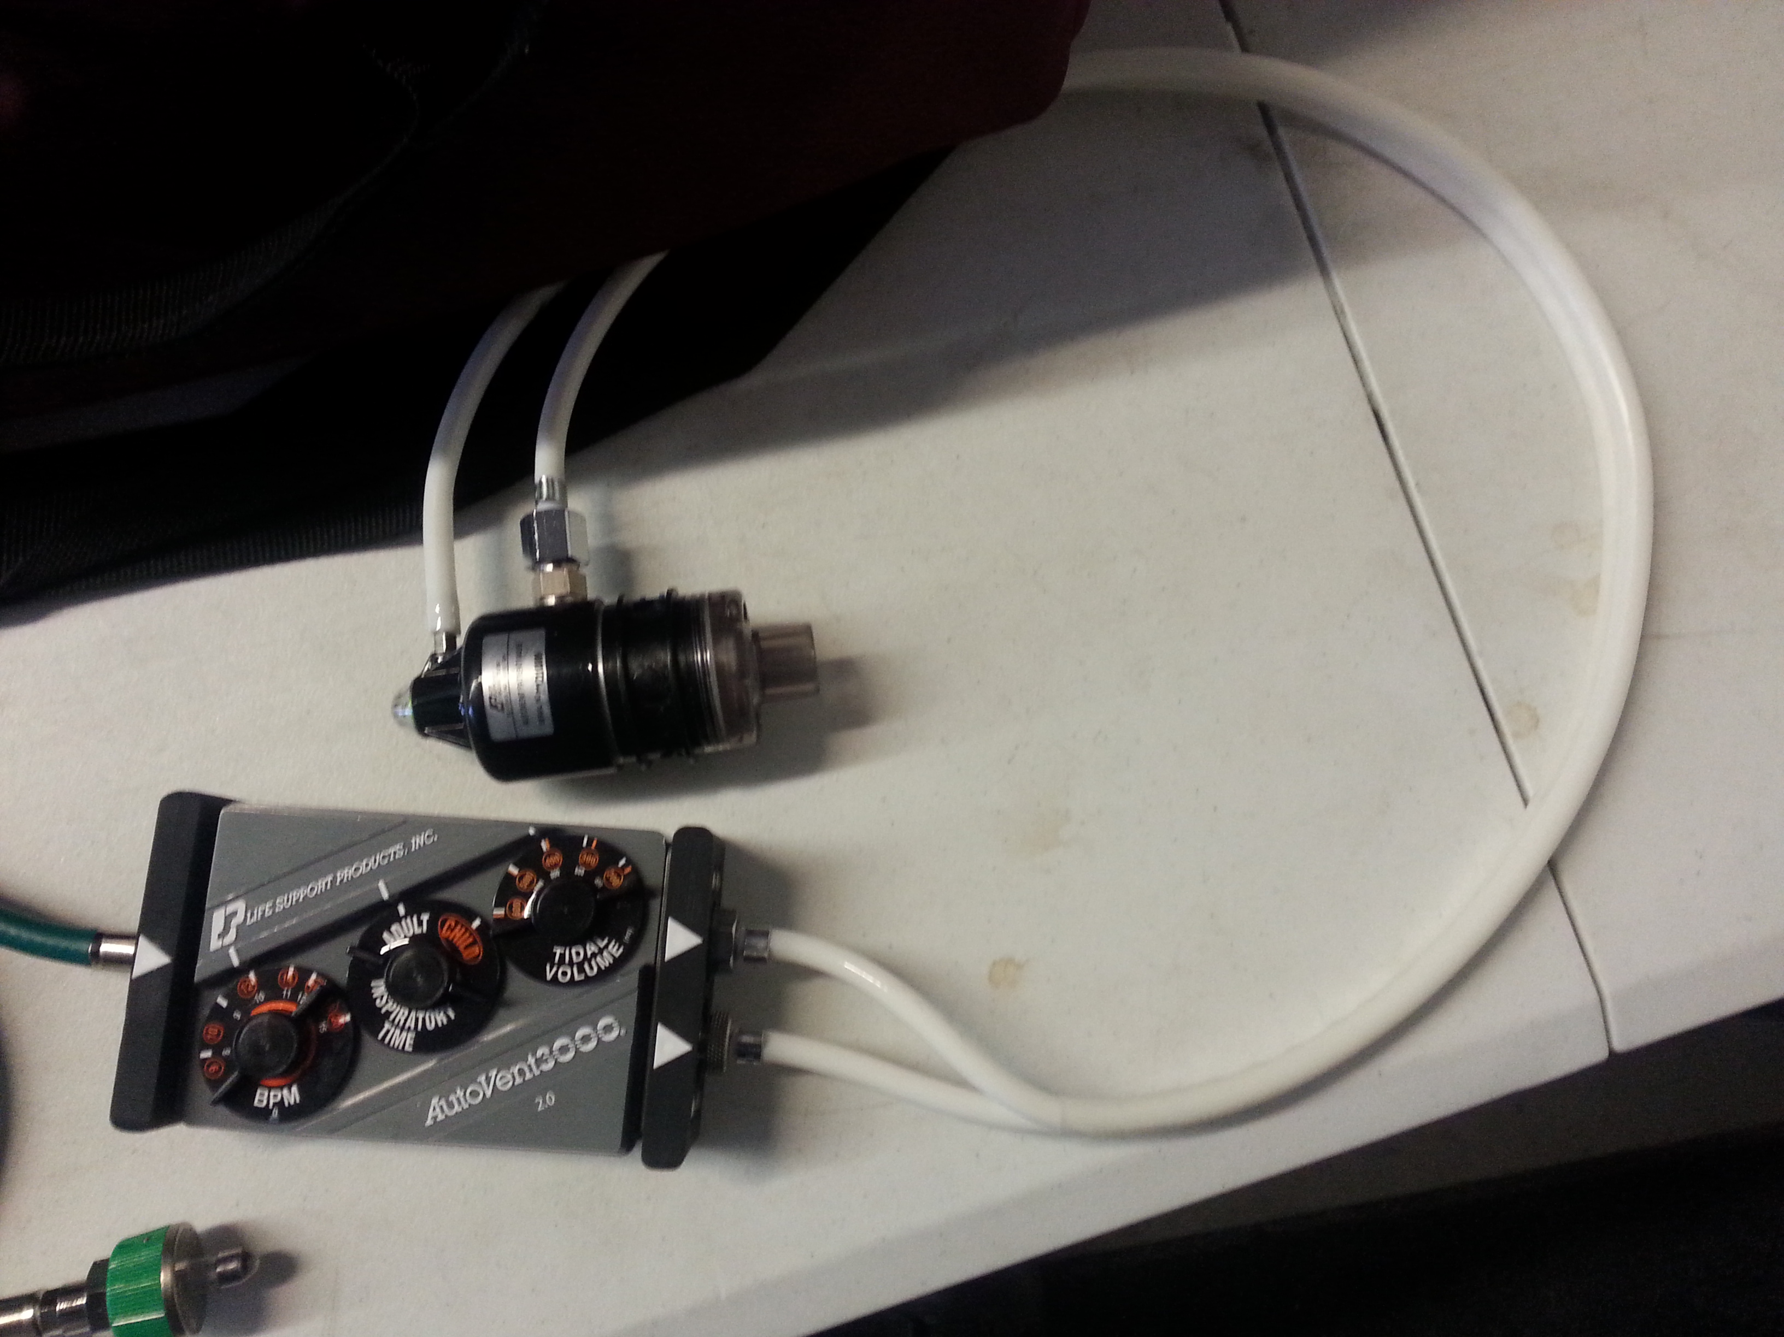
AutoVent 3000
Easy connection regulator

Slide 28
Review
Provide Standard Care
EKG/EtCO2/SpO2
Do the math for the Vt
BVM before Vent
Check your settings
Every time you move check the tube and check lung sounds.
DOPE
For more information see:
http://specmed.org/2013/04/02/ventilator-management-in-the-transport-environment/

Slide 29
Resources
http://www.specmed.org
http://www.mlrems.org

